Slide 1

Shrinking The Shrink
Data Science Proposal
Dec 2021

Slide 2
Introduction
The problem with Expiry Shrink
Not able to be salvaged or donated
Loss of both sales as well as write-off potential
Batch visibility isn’t available currently
What we aim to do
Obtain transparency on current stock batch levels
Needs to be very User-friendly
Determine volatility of current stock levels
Provided in terms of percentage chance of expiring
Impact Hypothesis
By identifying the probability of current stock items expiring out, we can take steps to reduce the level of shrink loss due to expiry.

Slide 3
Methodology
Data Needed
On Hand stock collected by each Outlet
Historical Sales Data for NA Outlets
Historical Shrink Data for NA Outlets
Tools Utilized
Excel for data collection, sorting, and cleaning
Tableau for data visualization and ease of access
Python for eventual modeling and prediction

Slide 4
Results
Where we are and
Where we want to go

Slide 5
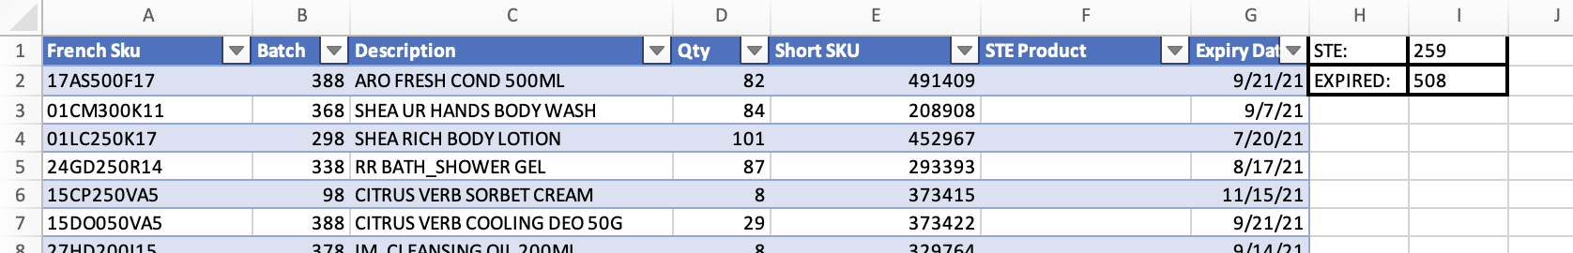
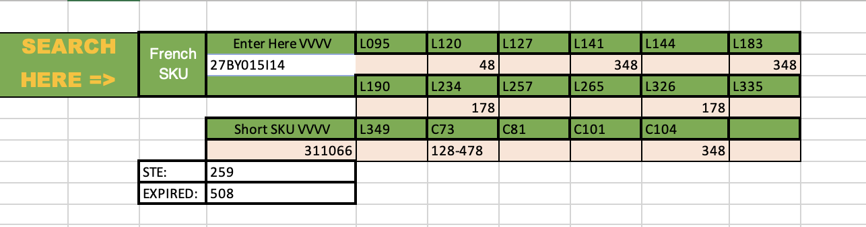
On Hand Batch Transparency
We have implemented an excel spreadsheet across our shared Microsoft Teams group which enables quick easy access to update current on hand values to all outlets at all times.

Slide 6
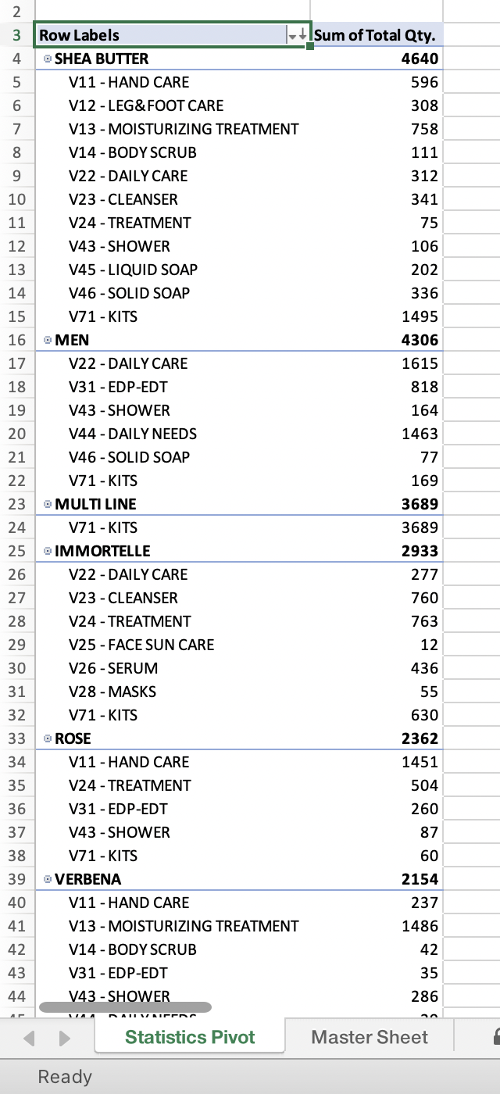
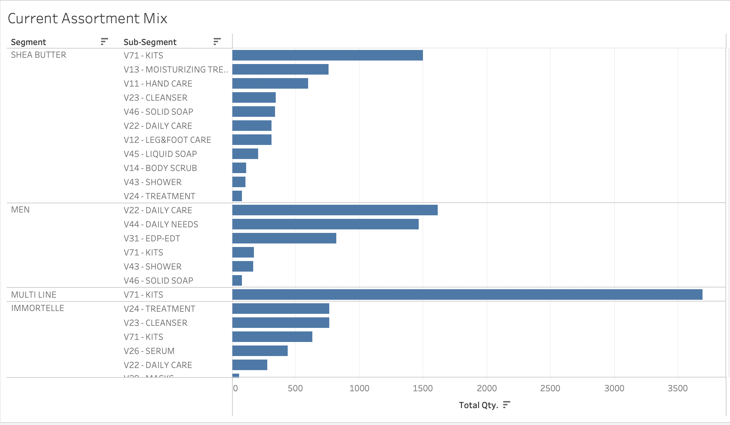
Statistical Data
Key Takeaways:
Despite being most popular, Shea overwhelmingly is also the highest stock at risk
Hand Care subsegment also consistently at high risk

Slide 7
Next Steps
With the current batch information we can now collect and easily interact with we can build a predictive model that will determine likelihood of product expiry
Promotional Planning for current stock levels
Better informed ordering from producer
Increased information about customer purchase trends
Can be informed by region

Slide 8
Conclusions

Slide 9
Insights and Suggestions
Given that batch information is now available for on-hand stock, steps could be taken to address those prior to their expiry
Brand protection of the Most Loved lines may be resulting in high expiry loss at Outlets. A cost-benefit analysis should be made into this in particular to determine how to best address
If provided with historical sales and shrink data, a predictive model could be made to determine likelihood of a product expiring, allowing for more preemptive planning to prevent loss

Slide 10
Thank You
Your time has been appreciated

